Slide 1


PROJECT 4 – FINAL PRESENTATION TITLE : MACHINE LEARNING IN PREDICTING INSURANCE MEDICAL CHARGES GROUP MEMBERS: 1. NOR HAMIZAH BINTI MUSTAFFA 2. NORMIEZA BINTI AZHAR 3. wan eizhaN afeef bin wan ahmad faizal
GA TRAINING 2021 – 281021 (THURSDAY)

Slide 2
CONTENTS
2. Business & Data Understanding
1. Project Overview
3. EDA
4. Approach Reasoning
6. Key Insights
Next Actions
Improvements
5. ML/Model Results

Slide 3
BUSINESS OVERVIEW
INDUSTRY/DOMAIN: Insurance Industry
COMPANY: Insurance Company
BUSINESS PROBLEM : How do medical insurance costs of people characterized by certain attributes.
BUSINESS OBJECTIVES:
a) To predicting health insurance premiums based on individuals characterized by specific attributes
HYPOTHESIS/ASSUMPTIONS : Insurance premium cost increases when the insured person has higher risks of attributes.
GOALS AND SUCCESS METRICS:
a) Pricing teams of the insurance company able to set a profitable price on the healthcare insurance.
b) End customer which is the insured person able to get affordable price on the healthcare insurance.
RISK OR LIMITATIONS:
(a) Each individual/insured person attribute are very important.

Slide 4
BUSINESS & DATA UNDERSTANDING
The main foundational block of health insurance industry is to estimate the future events and measure the associated risk/value of these events, hence it is needless to say that predictive analytics is used widely to determine the risk, insurance premium and enrich overall customer experience.
Determine the policy premium for the insured based on their behaviors which are indicated by attributes such as age, BMI (Body Mass Index), smoking habits, number of children.
This determination of premiums based on the data collected for an individual helps insurance companies in enhanced pricing, underwriting and risk selection
Age
Sex
BMI
Children
Smoker
Region
Charges

Slide 5
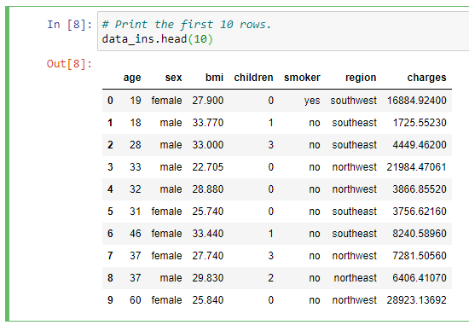
EXPLORATORY DATA ANALYSIS
Overview Of The Dataset

Slide 6
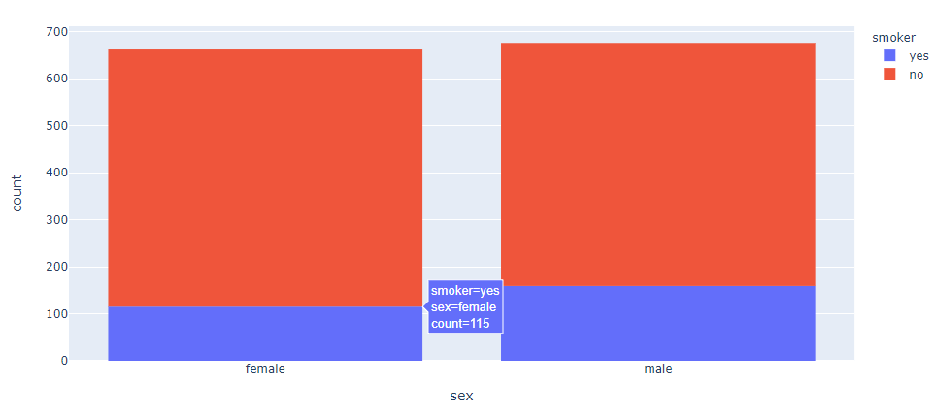
EXPLORATORY DATA ANALYSIS
Number Of Smokers Based On Gender

Slide 7
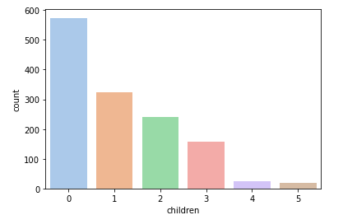
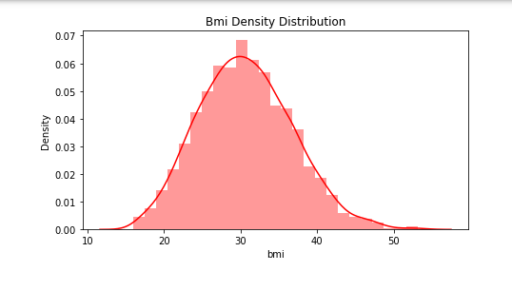
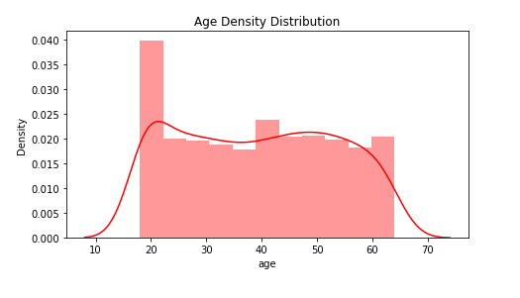
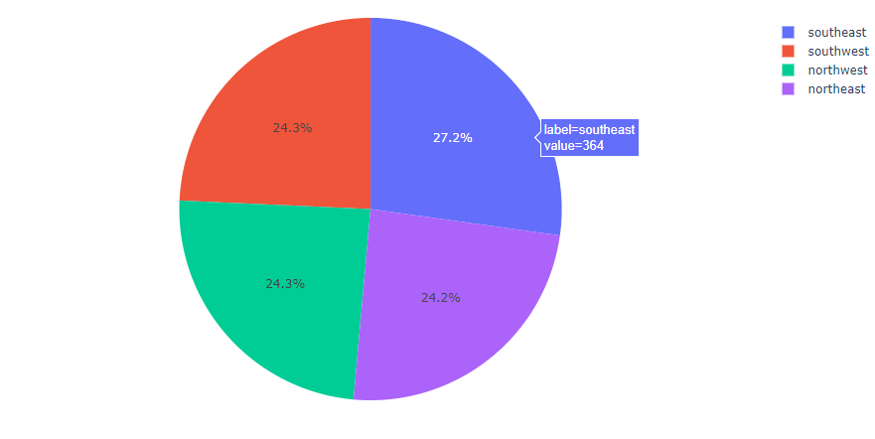
EXPLORATORY DATA ANALYSIS
Number and Density For Every Feature

Slide 8
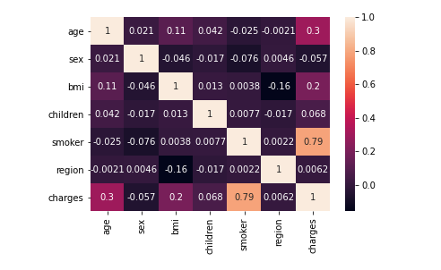
EXPLORATORY DATA ANALYSIS
Top 4 Factors That Affects Medical Cost
1) Smoker
2) Age
3) BMI
4) Children

Slide 9
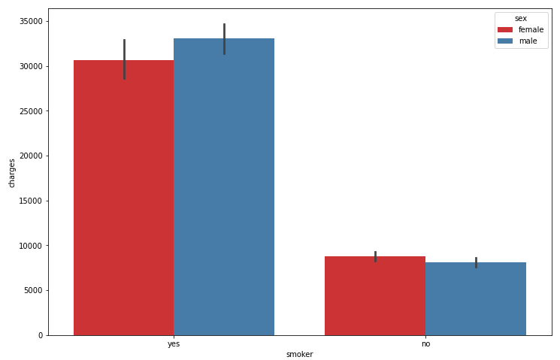
EXPLORATORY DATA ANALYSIS
Medical Charges Based On Smoker and Sex

Slide 10
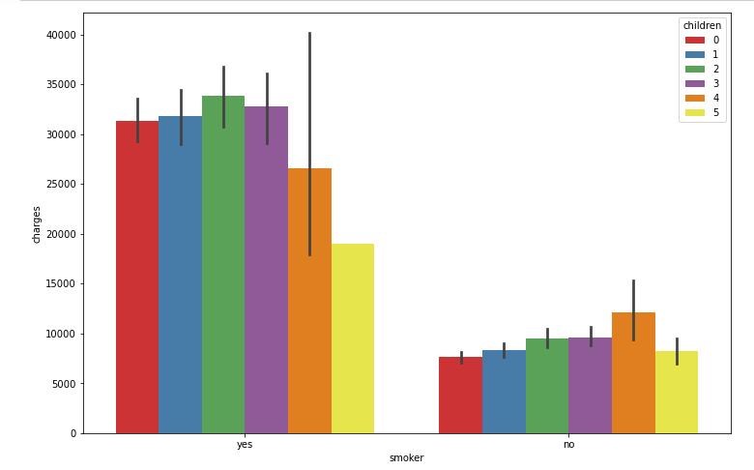
EXPLORATORY DATA ANALYSIS
Medical Charges Based On Smoker And Number of Children

Slide 11
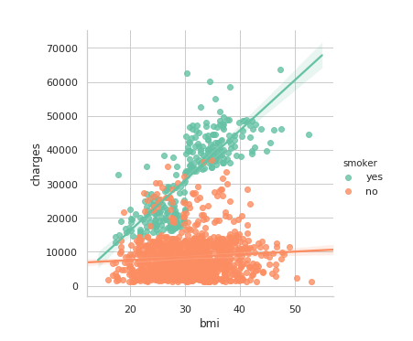
EXPLORATORY DATA ANALYSIS
Medical Charges Based On BMI and Smoker

Slide 12
REASONING FOR USING CURRENT APPROACH
We use Linear Regression and Random Forest Model
Linear Regression used to predict value of a variable based on the value of other variable.
Random Forest able to produce understandable and good predictions with higher level of accuracy.
Predicting insurance costs require high accuracy as it may help insurance providers to attract customers and save time in formulating best packages for the clients.
Random Forest Model offers better performance in term of accuracy compared to Linear Regression Model.
Linear Regression: 76.82%
Random Forest: 86.08%

Slide 13
ML MODEL – LINEAR REGRESSION VS RANDOM FOREST
The performance of each model can be evaluated based on this measurement:
Mean Squared Error (MSE)
Root Mean Squared Error (RMSE)
R-squared (R²)
The performance of each model can be evaluated based on this measurement:
Mean Squared Error (MSE)
Root Mean Squared Error (RMSE)
R-squared (R2)
Lower RMSE value, higher the accuracy of the predicted value; Higher the R2 value, the better the model output
Linear Regression | Attributes | Random Forest
36833293.755 | MSE | 26223507.706
6069.044 | RMSE | 5120.889
0.7612 | R² | 0.8299

Slide 14
ML MODEL RESULT – LINEAR REGRESSION
The dataset was split randomly using Train-Test-Split approach with ratio of 80:20.
Variable | Coefficient | Interpretation of Coefficient
Age | 267.521 | 1 unit of Age increase/decrease, the medical insurance cost would increase/decrease by 267.521
Smoker | 23635.487 | 1 unit of Smoker increase/decrease, the medical insurance cost would increase/decrease by 23635.487
Children | 413.188 | 1 unit of No. of Dependent increase/decrease, the medical insurance cost would increase/decrease by 413.188
BMI | 311.513 | 1 unit of BMI increase/decrease, the medical insurance cost would increase/decrease by 311.513

Slide 15
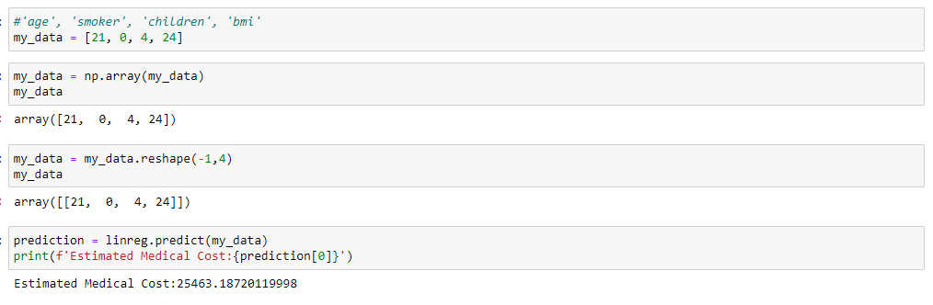
ML MODEL RESULT – RANDOM FOREST
Our model used default value number of trees of 100 and measuring the quality of data split based on Mean Squared Error (MSE).
Value of Predicted Value against the Actual Value using Random Forest:
Producing Estimated Cost based on the value of the variables:

Slide 16

1. Forecasting insurance costs based on certain factors help insurance policy providers to attract consumers and save time in formulating plans for every individual. 2. ML can significantly minimize these individual efforts in policymaking, as ML models can do cost calculation in a short time, while a human being would be taking a long time to perform the same task. 3. The insured health status attributes which are smoker, age, bmi, children significantly contributing to charges of medical cost. 4. Smoking gives the greatest factor that affects medical cost charges, followed by age and bmi. 5. Health insurance companies can then accurately charge the premium based upon a specific individual’s attributes.
KEY INSIGHTS FOR BUSINESS

Slide 17
NEXT ACTION FOR BUSINESS
✓ WHO deserve which kind of insurance plan?
✓ HOW much the premium should be charged based on an individual’s health behaviour?
✓ PREDICT their premium helps in better risk management based upon an individual’s behaviour relationship with
the medical charges.
✓ CREATE trust between the customer and the insurance company.
- Collect and analyze the insured health data and personal information to accurately predict the risk and charge
accurate premiums to cover that risk.

Slide 18
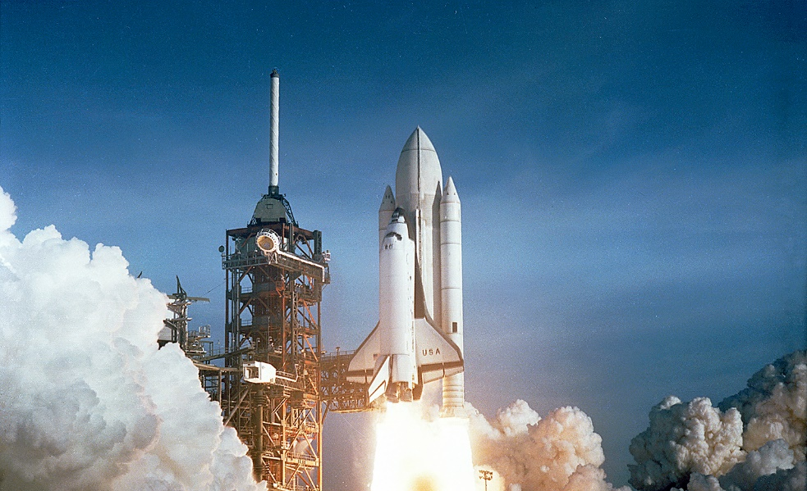
✓ The data do not include any information on an individual’s medical costs, the real-time data. ✓ The ML model in predicting medical charges must be build with high accuracy
KEYPOINTS IMPROVEMENTS AND FOCUS

Slide 19
THANK YOU

